Slide 1
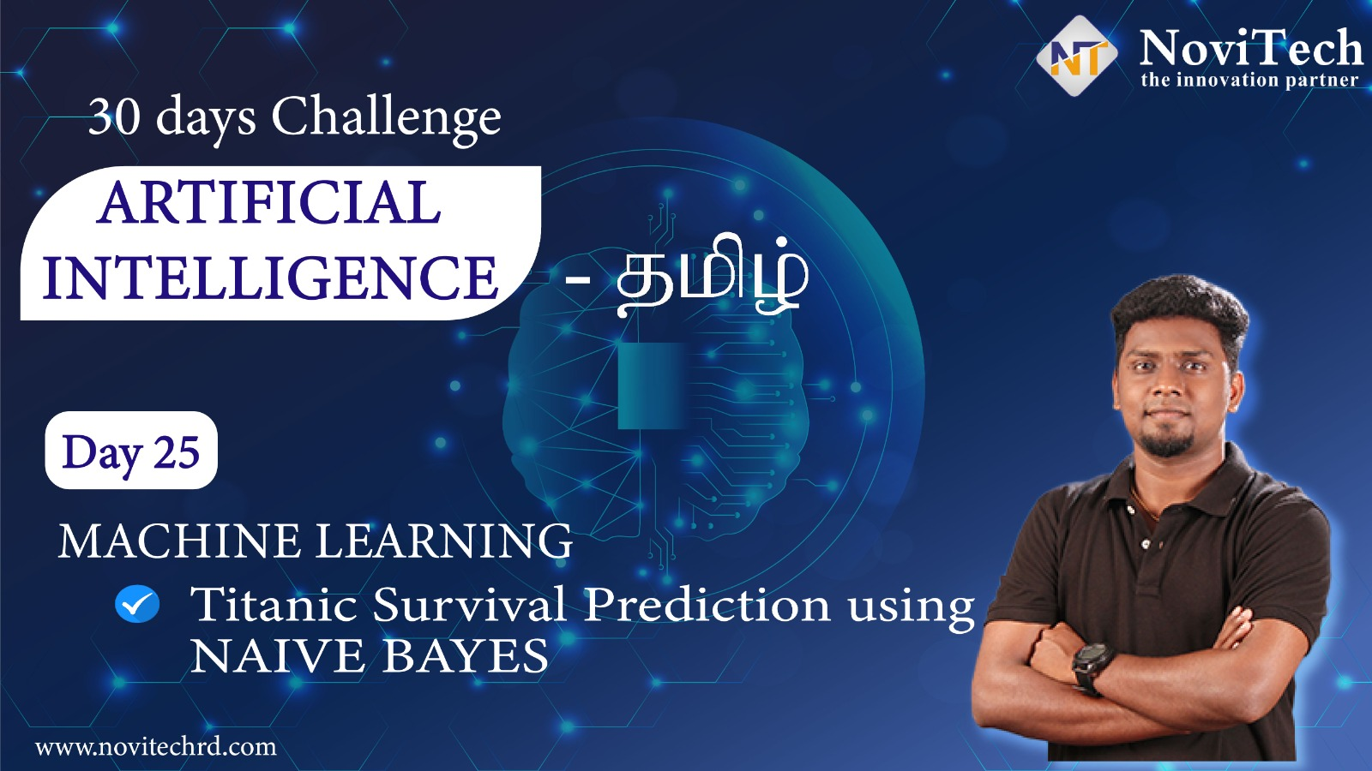

Slide 2
Announcement
Attendance link will be shared in between the session or at the end of the session
Minimum 25 Days Attendance required to receive your FREE E-CERTIFICATE (with same mobile number & email id)

Slide 3
Prerequisites for this Course
Be Ready with sufficient data
Laptop with Good Internet
No basic knowledge is required.
Note & Pen

Slide 4
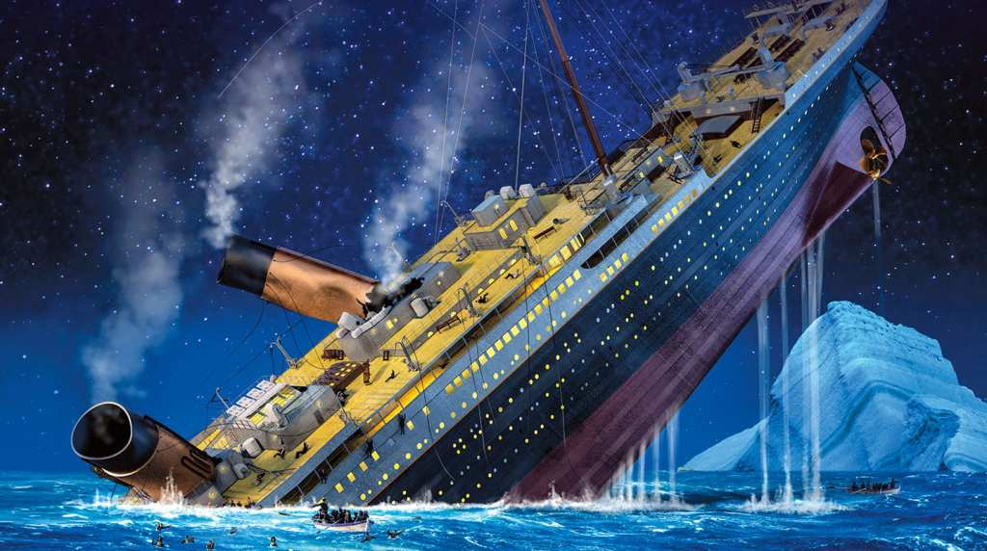
Titanic Survival Prediction
Predicting survival on the Titanic involves using a computer program to learn from information about passengers and then make predictions about whether a passenger survived or not. First, we organize the data, making it suitable for the computer to understand.
We then choose a method for the computer to learn from the data, train the model by showing it examples, and evaluate its accuracy by testing it with new information. If the predictions aren't accurate enough, we can adjust the model. The goal is to create a reliable system for guessing whether a person survived or Not survived

Slide 5

Basic Steps to Create a Model
Data Collection
Data Pre-Processing
Choosing a Concept
Model Training
Model Evaluation
Parameter tuning(optional)
Model prediction

Slide 6
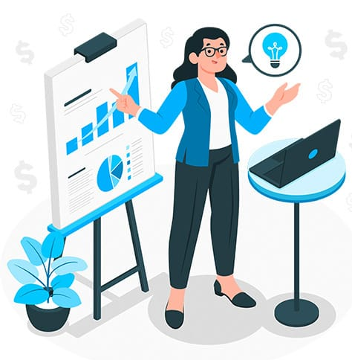
Exploratory Data Analysis (EDA)
Exploratory Data Analysis (EDA) is a crucial step in understanding and unraveling the story within a dataset. It's like closely examining the ingredients of a recipe before cooking. EDA involves checking for missing pieces, understanding the distribution of information, and creating visual snapshots of the data's patterns.

Slide 7

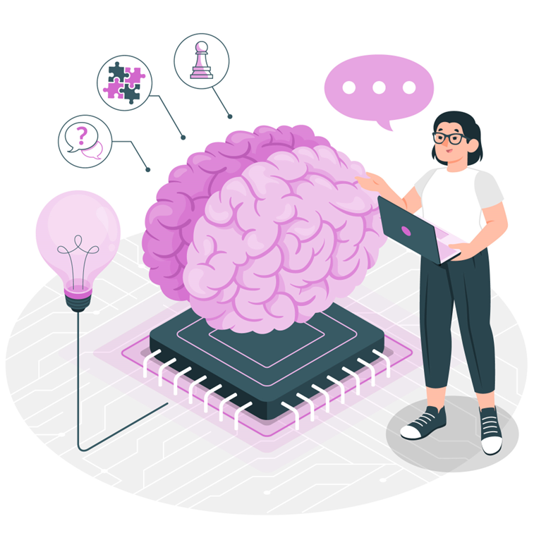
Machine Learning
Titanic Survival Prediction

Slide 8
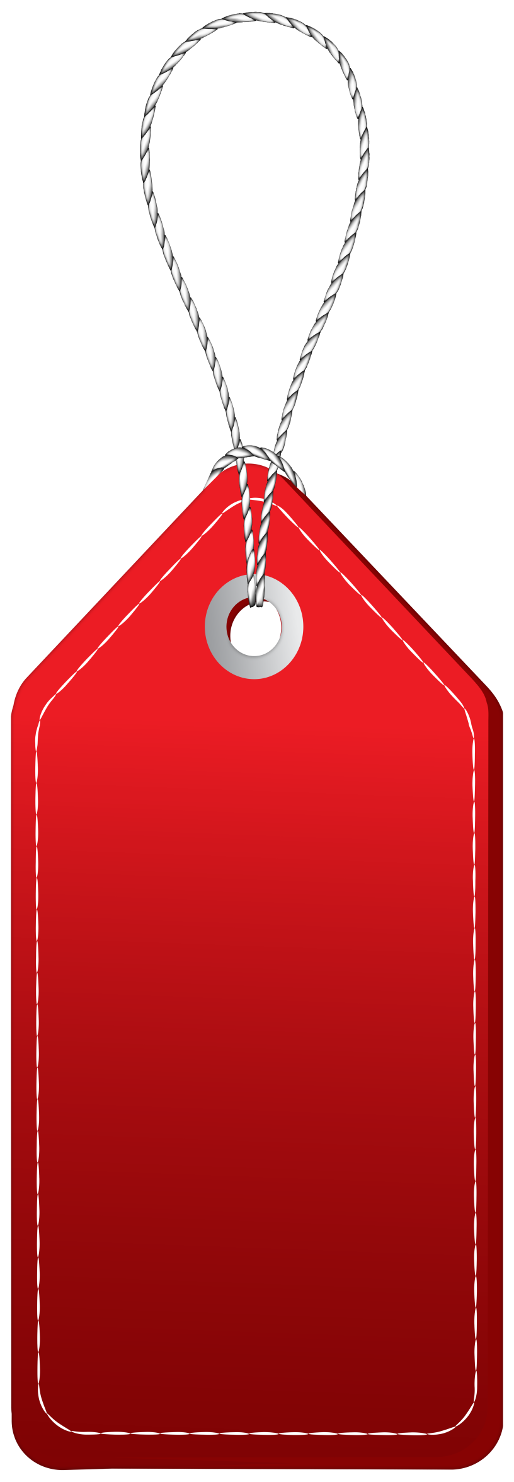

Solution - Internship
30 Day Recorded Video Lectures
(₹4000)
20+ Projects
(₹30,000)
Bonus Task, Assignments
(₹1,500)
Technical Material(PPT, Mindmap)
(₹1,000)
Rs.40,000
200 AI Interview Questions
(1500)
Rs.1,999
Certificate For Internship with your Photocopy
(₹2,000)
Daily Live Q&A Session
Lifetime Course Validity

Slide 9
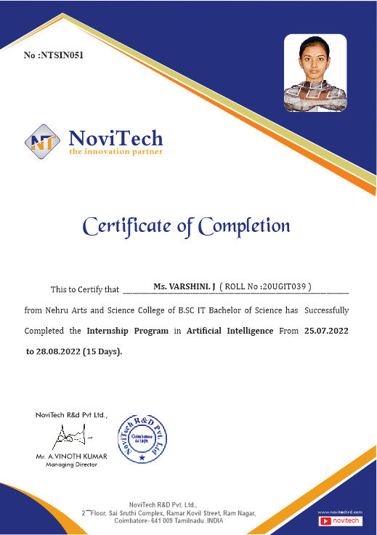

Slide 10
Mindset of the Day
If you don't learn anything from failure, then that is the real failure..!!

Slide 11
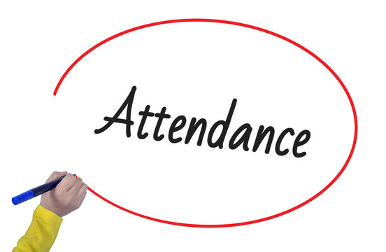
Post Your Attendance

Slide 12




THANK YOU☺
Join our What’s app Community group
novitechresearchanddevelopment

Slide 13
Post Your Attendance

Slide 14
THANK YOU☺
Join our What’s app Community group
novitechresearchanddevelopment

